Slide 1
OPER 623 – Overviews: Heuristic Methods and Complexity
Lesson 7
Local Search

Slide 2
Outline
Local Improvement Algorithms
Definition
Topology
Moves
Neighborhoods
Landscapes

Slide 3
Heuristics
In general, there are two broad classes of fundamental heuristics
Constructive – Covered last week
Local Search – Today’s Lecture
Local Search dates back to the last 1950s and early 1960s when edge exchanges were explored for TSP.
Since then, local search has been applied to a wide variety of combinatorial optimization problems
Scheduling
Network Design
Vehicle Routing
Cutting Stock

Slide 4
Local Improvement Algorithms
Definitions
Move – a method for altering the current solution
Neighborhood – Given a current solution c, the neighborhood of c, N(c) is the set of all solutions reachable from c via a single move
Evaluation Method – Method you use to choose from solutions in the neighborhood
These definitions should seem very familiar to constructive heuristics. What then is the difference?
Constructive starts at null set and slowly builds a solution
Local search starts at a solution and uses these mechanics to move to new solutions

Slide 5
Local Improvement Algorithms
Local Search can be applied to both feasibility problems and optimization problems.
Feasibility Problems: Seek a solution that satisfies all of the constraints.
One local search technique for feasibility problems is to transform them into optimization problems.
How? Quantify the number of violated constraints and then solve as an optimization problem!

Slide 6
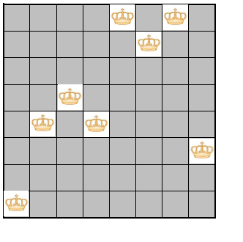
Feasibility Example – 8 Queens
Given a solution to a feasibility problem

Slide 7
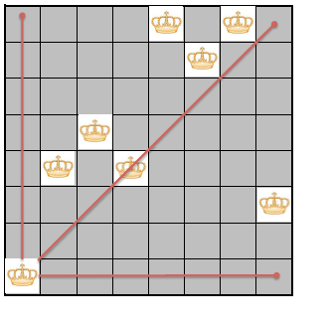
Feasibility Example – 8 Queens
Quantify how “infeasible” the solution is

Slide 8
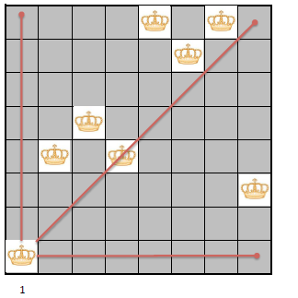
Feasibility Example – 8 Queens
This queen violates one constraint

Slide 9
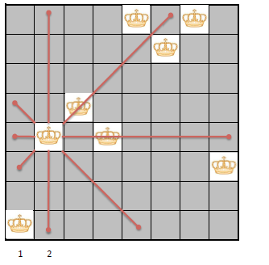
Feasibility Example – 8 Queens
This queen violates two constraints

Slide 10
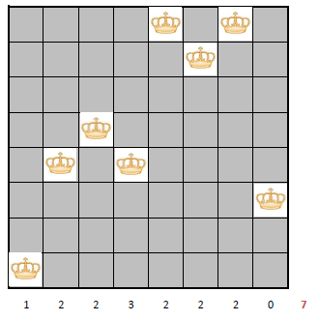
Feasibility Example – 8 Queens
So on…

Slide 11
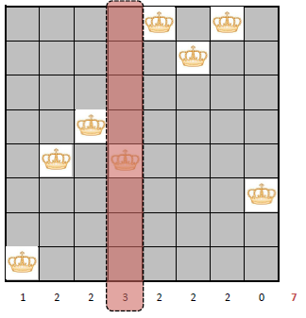
Feasibility Example – 8 Queens
Chose the worst offender

Slide 12
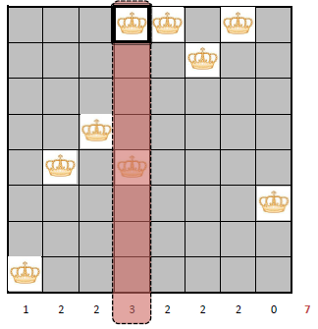
Feasibility Example – 8 Queens
Examine different new positions for that offender

Slide 13
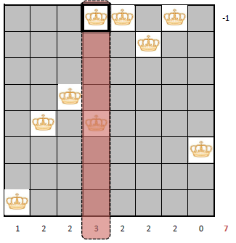
Feasibility Example – 8 Queens
How would each new position reduce the violated constraints

Slide 14
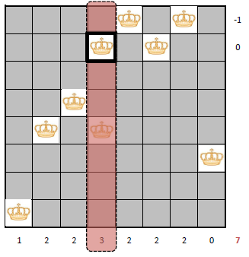
Feasibility Example – 8 Queens

Slide 15

Feasibility Example – 8 Queens

Slide 16
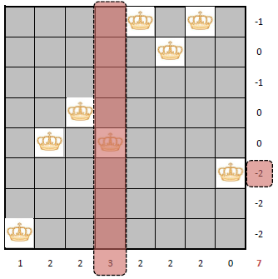
Feasibility Example – 8 Queens
Chose a new position that reduces violations as much as possible

Slide 17
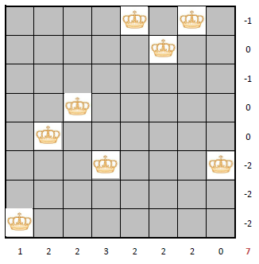
Feasibility Example – 8 Queens
Move queen to that new position

Slide 18
Local Improvement Algorithms
Optimizing some objective function f .
Define a move, which in turn defines the neighborhood N for our current solution c.
What was a move in the 8 Queens example?
What was a neighborhood in the 8 Queens example?
Local Search gets you to a local minima.
Definition: The Local Minima is solution c such that for all neighboring configurations n ∈ N(c), we have f (n) ≥ f (c)

Slide 19
Local Improvement Algorithms
Basic algorithm
1. Generate a starting solution c
2. Evaluate the neighborhood N(c)
3. If an improving neighboring solution can be found replace the current solution and go to Step 2.
4. If no improving neighboring solution can be found, terminate with local optimum.

Slide 20
Local Improvement Algorithms
No guarantees for global optimality.
More sophisticated metaheuristics look at modifying local search and ways to escape local minima.
For feasibility problems, if f (c) = 0, we are at a global optimum.

Slide 21
Local Improvement Algorithms
Choice of move definition
Determines neighborhood size
Too large neighborhood – takes too long to evaluate
What if an “8-Queens” move was any arbitrary number of standard queen chess movements?
Too small neighborhood – takes too long to change the solution quality
What if an “8-Queens” move was to move a queen only a single square?
What is the right size?
Must provide connectivity
Must be able to get from any solution to any other feasible solution

Slide 22
Local Improvement Algorithms
Neighborhoods
Evaluation
First “improving” neighbor chosen
“Best” neighbor chosen (Hill-climbing)
Some metaheuristics even allow a “worse” neighbor!

Slide 23
Traveling Salesman Problem
What is an example of one move, and thus one neighborhood for the TSP?

Slide 24
Traveling Salesman Problem: 2-OPT
Start with a feasible tour
Take any two edges in the tour and swap them with two edges that are not currently in the tour.

Slide 25
Traveling Salesman Problem: 2-OPT

Slide 26
Traveling Salesman Problem: 2-OPT
Start with a feasible tour. Random or maybe via a constructive heuristic.

Slide 27
Traveling Salesman Problem: 2-OPT
Remove two edges

Slide 28
Traveling Salesman Problem: 2-OPT
This removal has now broken tour into disconnected graphs

Slide 29
Traveling Salesman Problem: 2-OPT
Need to reconnect these four nodes
Don’t want to reuse edges we removed

Slide 30
Traveling Salesman Problem: 2-OPT
This edge is already in tour, so no sense adding it back

Slide 31
Traveling Salesman Problem: 2-OPT

Slide 32
Traveling Salesman Problem: 2-OPT
These two edges create a new tour

Slide 33
Traveling Salesman Problem: 2-OPT

Slide 34
Traveling Salesman Problem: 2-OPT
Repeat…

Slide 35
Traveling Salesman Problem: 2-OPT

Slide 36
Traveling Salesman Problem: 2-OPT
The 2-OPT Neighborhood
The set of all tours that can be reached by swapping two edges.
Select two edges and replace them with two other edges
Why only consider 2?

Slide 37
Traveling Salesman Problem: 3-OPT
The 3-OPT Neighborhood
The set of all tours that can be reached by swapping three edges.
Select three edges and replace them with three other edges

Slide 38
Traveling Salesman Problem: 3-OPT

Slide 39
Traveling Salesman Problem: 3-OPT

Slide 40
Traveling Salesman Problem: 3-OPT

Slide 41
Traveling Salesman Problem: 3-OPT

Slide 42
TSP-OPT Performance
3-OPT is better than 2-OPT in quality, but more computationally expensive.
4-OPT is marginally better in terms of quality, but much more
expensive.
5-OPT, 6-OPT, 7,-OPT, . . .
K-OPT
Replace the notion of one fixed number of swaps with a search for the most favorable number K of swaps at each iteration.
Do not search the entire set of sequences but build one incrementally.

Slide 43
K-OPT Main Idea Lin-Kernighan heuristic
Find a good K dynamically at a fraction of the cost by exploring a sequence of swaps of increasing size

Slide 44
K-OPT Algorithm Lin-Kernighan heuristic
Choose some vertex v1 and an edge incident to v1, call the other end of this edge v2, and call this edge e1. This edge e1 is in the original tour.
Choose another edge e2 = (v2, v3) that is incident to v2 but not in the tour where the cost of e2 < e1.
If none exist, start over.
Else adding in e2 means vertices v2 and v3 has degree 3. Remove an edge e3 incident from v3
Remove e1 and add in an edge incident to v1 which fixes tour.
Compute the cost, but do not connect or implement.
Repeat step 4 from vertex incident to e3
Stop when there exists no moves that improve progress
Note: LK is not exploring all the possible k-opt exchanges it limits the exchanges to those incident to a sequential path

Slide 45
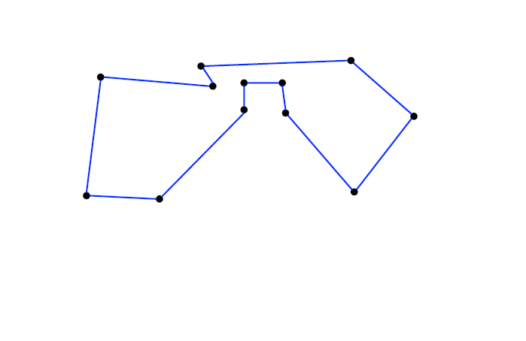
K-OPT Algorithm

Slide 46
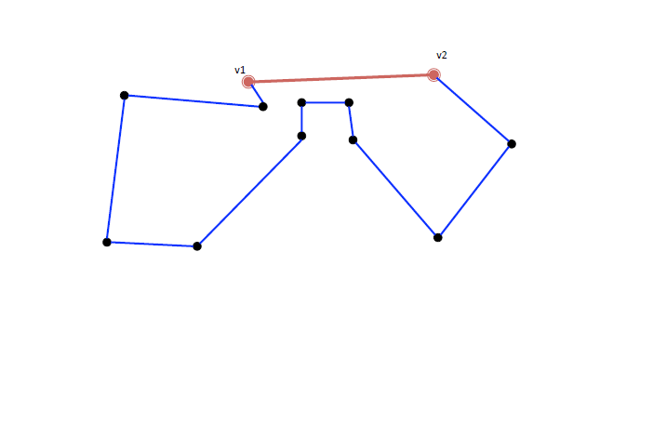
K-OPT Algorithm
Select an edge that is in tour

Slide 47
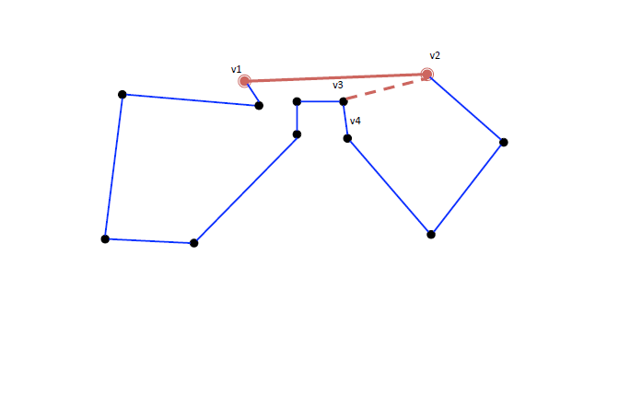
K-OPT Algorithm
Consider adding a shorter edge incident to v2
(v2,v3) is such an edge
If we add (v2, v3) v3 would have degree 3

Slide 48
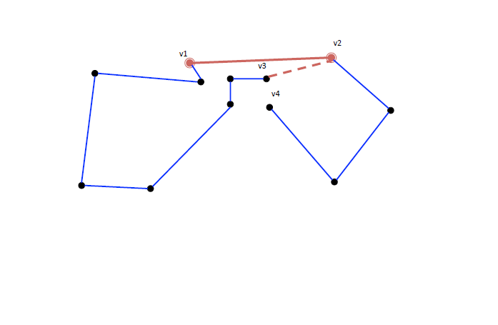
K-OPT Algorithm
Delete an edge incident to v3 which is in tour

Slide 49
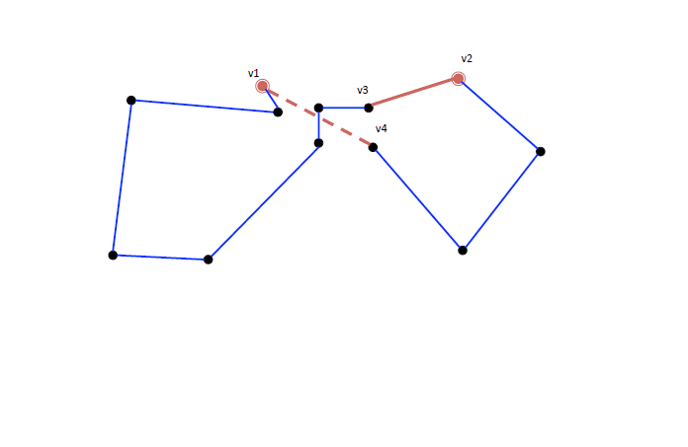
K-OPT Algorithm
Add edge incident to v1
Delete edge e1
This is now a 2OPT
Calculate potential savings

Slide 50
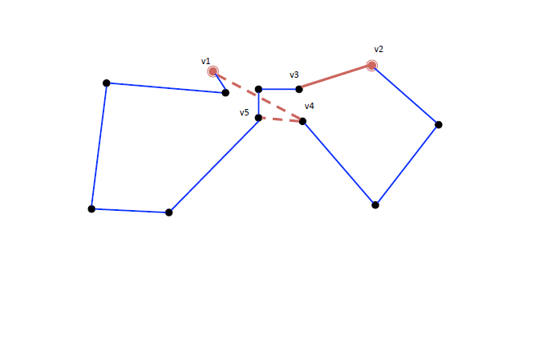
K-OPT Algorithm
Algorithm progresses with v4 now playing role v2 did before.
Consider adding edge incident to v4 that is cheaper then the (v1,v4) edge
Now v5 has degree 3

Slide 51

K-OPT Algorithm
This would require we delete an edge incident to v5
V6 has degree 1

Slide 52
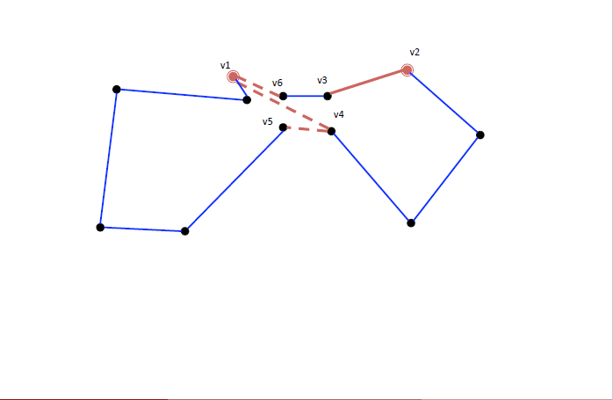
K-OPT Algorithm
Reconnect tour

Slide 53
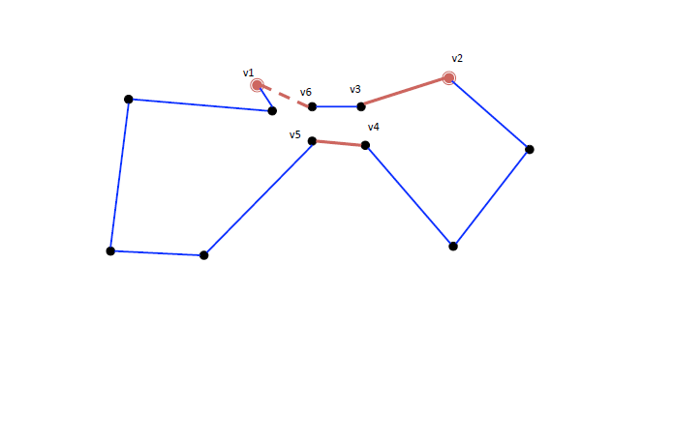
K-OPT Algorithm
Delete edge
This is a 3OPT
Calculate savings

Slide 54
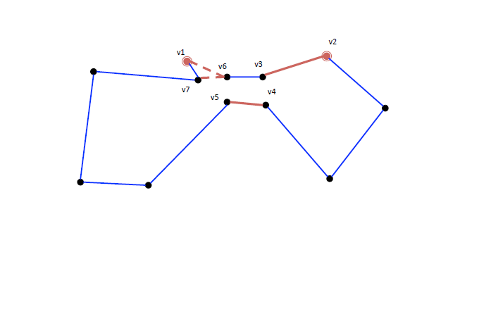
K-OPT Algorithm
Algorithm progresses with v6 now playing role v4 (and prior to that v2) did before.

Slide 55
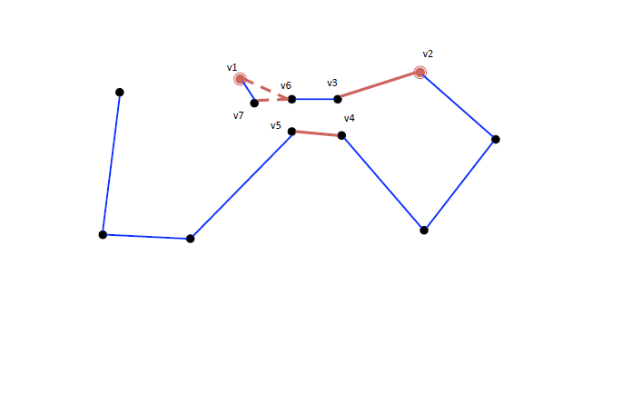
K-OPT Algorithm

Slide 56
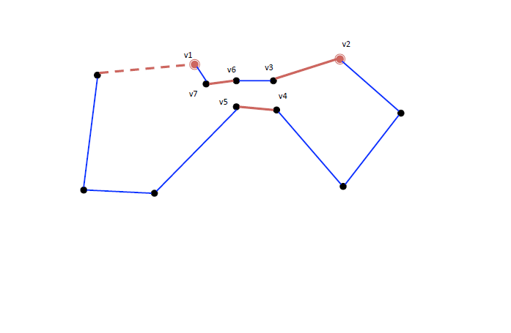
K-OPT Algorithm
This is a 4OPT
Calculate savings
Terminate because no cheaper edges exist

Slide 57
TSP: K-OPT
This forms the first iteration.
We stop because at this point we cannot find a smaller edge to add.
We look back at the 2-OPT, 3-OPT, and 4-OPT, and implement the best one.
We then continue for future iterations.
The nice thing is that we looked at a complicated neighborhood without having to enumerate all of the possible neighborhoods.
The key is that search is limited to node v1 and then a succession of nodes (v2 then v4 then v6). This way you are not searching all K opt

Slide 58

Break

Slide 59
Local Search: Magic Square
Magic Square constraints:
Each row must sum to 15
Each column must sum to 15
Both diagonals must sum to 15
Use all numbers 1-9 once

Slide 60
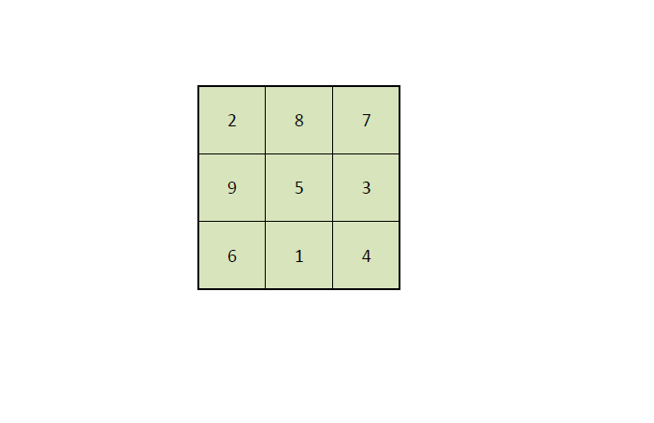
Local Search: Magic Square
Start with this infeasible solution
Develop a local search feasibility heuristic
Define your function f
Define a move
Apply your heuristic to find a feasible solution

